Slide 1
Introduction to Python 3.6
Smita B Kumar

Slide 2
Introduction to Python 3.6 What is Python? Benefits and feature of Python Where to use Python Interpretation process Installing and configuring Python

Slide 3
What is Python?
Python is an easy to learn, powerful programming language. It has efficient high-level data structures and a simple but effective approach to object-oriented programming.
Python’s elegant syntax and dynamic typing, together with its interpreted nature, make it an ideal language for scripting and rapid application development in many areas on most platforms.
Python is an interpreted scripting language also. Guido Van Rossum is known as the founder of python programming.
The Python interpreter is easily extended with new functions and data types implemented in C or C++ (or other languages callable from C). Python is also suitable as an extension language for customizable applications.

Slide 4
What is Python?
Python supports multiple programming pattern, including object oriented programming, imperative and functional programming or procedural styles.
Python is not intended to work on special area such as web programming. That is why it is known as multipurpose because it can be used with web, enterprise, 3D CAD etc.
We don't need to use data types to declare variable because it is dynamically typed so we can write a=10 to declare an integer value in a variable.
Python makes the development and debugging fast because there is no compilation step included in python development and edit-test-debug cycle is very fast.

Slide 5
Why Python?
● Simple to get started, easy for beginners, powerful
enough for professionals
● Code is clean, modular, and elegant, making it easy to
read and edit
● Whitespace enforcement
● Extensive standard library, many modules to import
from
● Cross platform - Windows, Mac, Linux
● Supportive, large, and helpful community

Slide 6
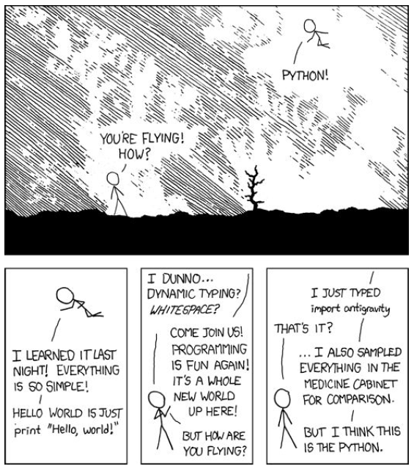
Why Python?

Slide 7
Who is using Python?
● Google
● Reddit
● Twitter
● Pinterest/Instragram
● DreamHost
● YouTube
● BitTorrent
● DropBox
● ...and countless more!

Slide 8
Benefits and feature of Python
There are a lot of features provided by python programming language.
Easy to Use:
Python is easy to very easy to use and high level language. Thus it is programmer-friendly language.
Expressive Language:
Python language is more expressive. The sense of expressive is the code is easily understandable.
Interpreted Language:
Python is an interpreted language i.e. interpreter executes the code line by line at a time. This makes debugging easy and thus suitable for beginners.
Cross-platform language:
Python can run equally on different platforms such as Windows, Linux, Unix , Macintosh etc. Thus, Python is a portable language.

Slide 9
Benefits and feature of Python
Free and Open Source:
Python language is freely available(www.python.org).The source-code is also available. Therefore it is open source.
Object-Oriented language:
Python supports object oriented language. Concept of classes and objects comes into existence.
Extensible:
It implies that other languages such as C/C++ can be used to compile the code and thus it can be used further in your python code.
Large Standard Library:
Python has a large and broad library.
GUI Programming:
Graphical user interfaces can be developed using Python.
Integrated:
It can be easily integrated with languages like C, C++, JAVA etc.

Slide 10
Where to use Python
Python as a whole can be used in any sphere of development.
Let us see what are the major regions where Python proves to be handy.
1) Console Based Application
Python can be used to develop console based applications.
For example: IPython.
2) Audio or Video based Applications
Python proves handy in multimedia section. Some of real applications are: TimPlayer, cplay etc.
3) 3D CAD Applications
Fandango is a real application which provides full features of CAD.

Slide 11
Where to use Python
4) Web Applications
Python can also be used to develop web based application. Some important developments are: PythonWikiEngines, Pocoo, PythonBlogSoftware etc.
5) Enterprise Applications
Python can be used to create applications which can be used within an Enterprise or an Organization. Some real time applications are: OpenErp, Tryton, Picalo etc.
6) Applications for Images
Using Python several application can be developed for image. Applications developed are: VPython, Gogh, imgSeek etc.
There are several such applications which can be developed using Python

Slide 12
Interpretation process
Python laid its foundation in the late 1980s.
The implementation of Python was started in the December 1989 by Guido Van Rossum at CWI in Netherland.
ABC programming language is said to be the predecessor of Python language which was capable of Exception Handling and interfacing with Amoeba Operating System.
Python is influenced by programming languages like:
ABC language.
Modula-3

Slide 13
Python Versions
Python Version | Released Date
Python 1.0 | January 1994
Python 1.5 | December 31, 1997
Python 1.6 | September 5, 2000
Python 2.0 | October 16, 2000
Python 2.1 | April 17, 2001
Python 2.2 | December 21, 2001
Python 2.3 | July 29, 2003
Python 2.4 | November 30, 2004
Python 2.5 | September 19, 2006
Python 2.6 | October 1, 2008
Python 2.7 | July 3, 2010
Python 3.0 | December 3, 2008
Python 3.1 | June 27, 2009
Python 3.2 | February 20, 2011
Python 3.3 | September 29, 2012

Slide 14
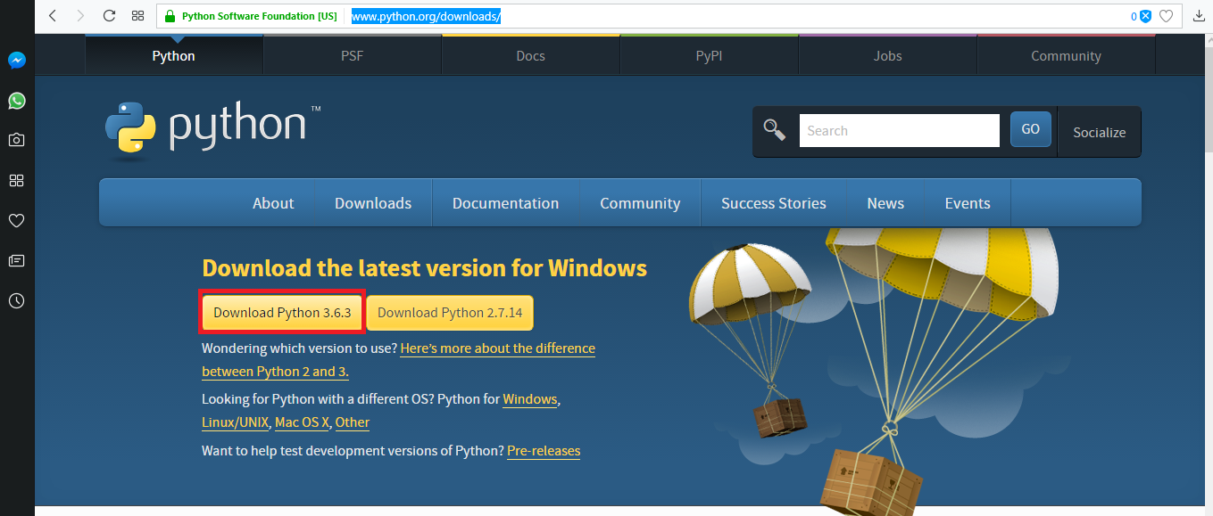
Installing and configuring Python
To install Python, firstly download the Python distribution from https://www.python.org/downloads/
Having downloaded the Python distribution now execute it. Double click on the downloaded software. Follow the steps for installation:

Slide 15
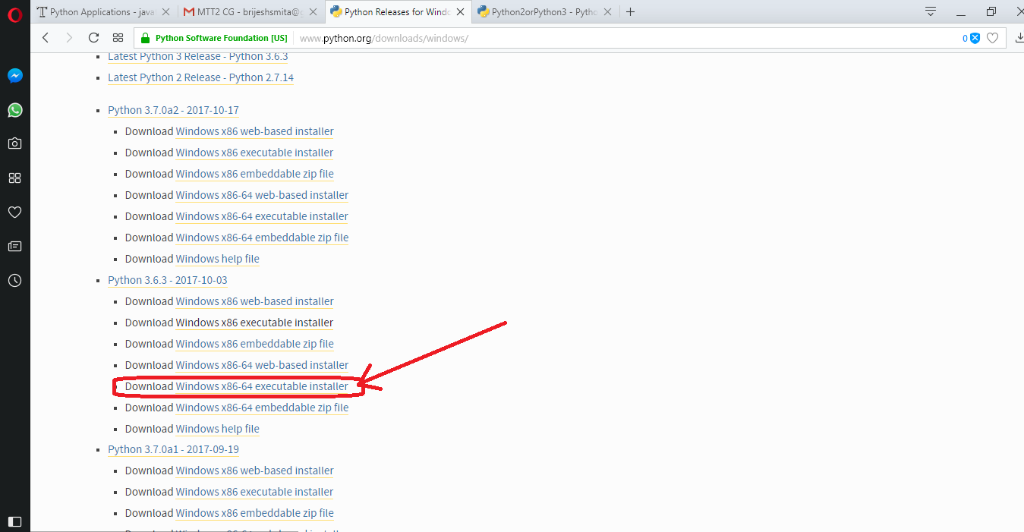
Installing and configuring Python
To install Python, firstly download the Python distribution from https://www.python.org/downloads/ OR

Slide 16

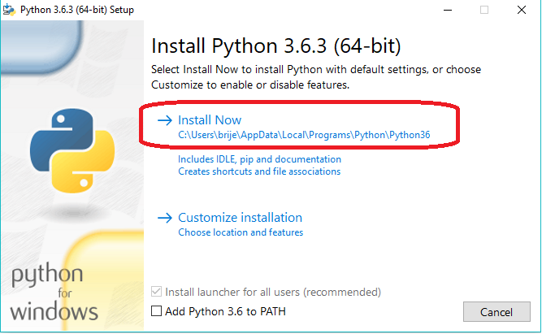
Installing and configuring Python
Having downloaded the Python distribution now execute it. Double click on the downloaded software. Follow the steps for installation:

Slide 17
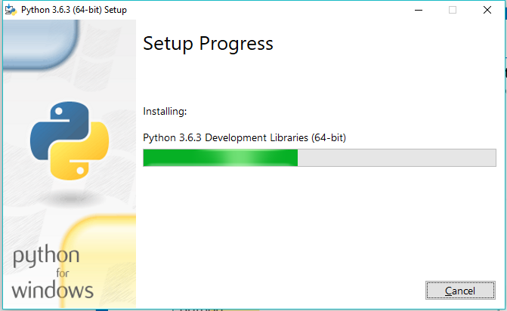
Installing and configuring Python

Slide 18
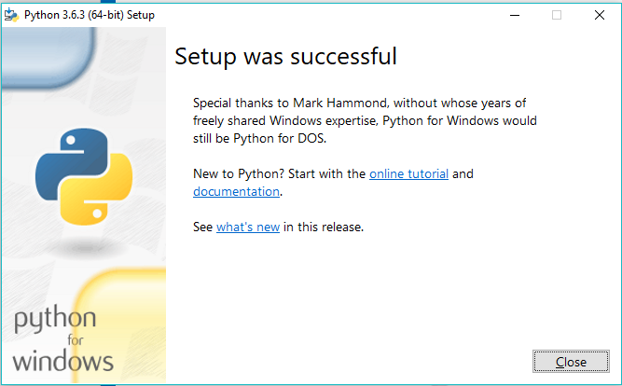
Installing and configuring Python
Now download PyCharm IDE for develeoping Python programs by Jet Brains
https://www.jetbrains.com/pycharm/download/

Slide 19
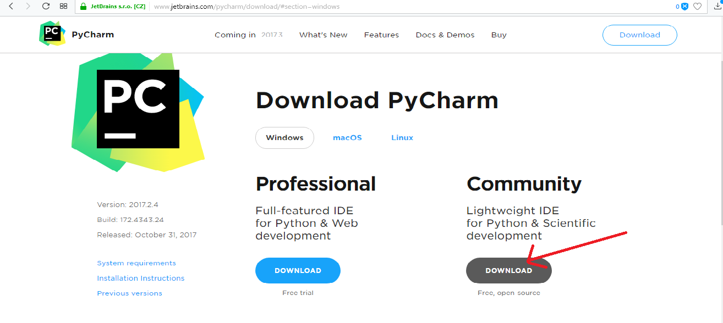
Download PyCharm
Now download PyCharm IDE for develeoping Python programs by Jet Brains
https://www.jetbrains.com/pycharm/download/

Slide 20
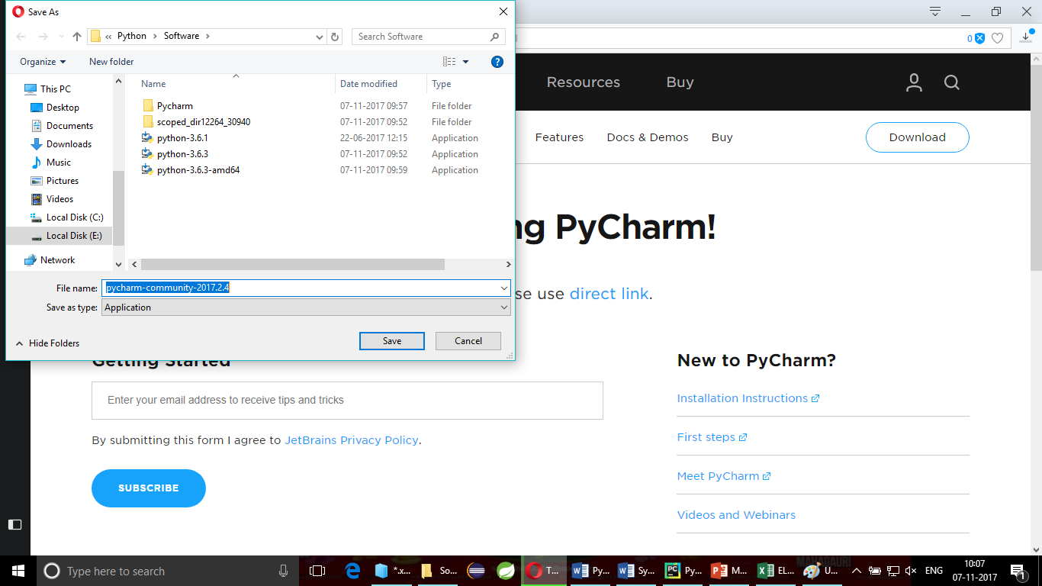
Download PyCharm
Now save it in the local disk and double click on the software and install. Create a desktop shortcut.

